Slide 1
CÀ PHÊ
FROM VIETNAM WITH LOVE
INDIA
Từ Việt Nam, với tình yêu.
SULEVINA GLOBAL VENTURES
(OPC) PRIVATE LIMITED
A premium Vietnamese-origin coffee brand
being developed for the Indian market.
BRAND & PARTNERSHIP INTRODUCTION
CÀ PHÊ / FROM VIETNAM WITH LOVE
01

Slide 2
01 / THE BRAND
Vietnamese coffee.
A distinctive point of view.
A premium proposition built on authentic origin, considered selection and a distinctive brand experience.
Cà Phê is being developed to introduce Indian consumers to authentic Vietnamese-origin coffee products, while respecting the flavour, character and heritage behind them.
CÀ PHÊ
FROM VIETNAM WITH LOVE
AUTHENTIC ORIGIN
PREMIUM EXPERIENCE
LONG-TERM THINKING
Vietnamese-origin products supported by supplier and product documentation.
A thoughtful range, clear product information and considered presentation.
Supplier relationships built around quality, consistency and mutual growth.
CÀ PHÊ / FROM VIETNAM WITH LOVE
02

Slide 3
02 / PRODUCT PORTFOLIO
A focused range to explore.
Initial product interests for supplier discussions and market testing.
01
VIETNAMESE 3-IN-1
02
PURE INSTANT BLACK
A convenient instant coffee format.
A straightforward coffee-led option.
03
COCONUT COFFEE
04
CHOCOLATE COFFEE
A distinctive flavour direction.
A familiar flavour paired with Vietnamese coffee.
05
ICED MOCHA & MORE
Additional varieties to assess with suppliers.
The launch assortment will be narrowed after tasting, cost validation and consumer feedback.
CÀ PHÊ / FROM VIETNAM WITH LOVE
03

Slide 4
03 / FORMAT EXPLORATION
Convenient formats, defined by the product.
Potential sachet weights are starting points for technical discussion—not final specifications.
2g
5g
10g
COMPACT SERVE
MID-SIZE SERVE
LARGER SERVE
To assess for suitable black coffee formulations.
To assess for flavour and serving strength.
To assess for richer or larger-serve products.
Final weights, recipes and preparation instructions will be determined by formulation, serving size and tasting tests.
CÀ PHÊ / FROM VIETNAM WITH LOVE
04

Slide 5
04 / INDIAN MARKET APPROACH
A considered route to market.
Build awareness and validate demand through complementary sales channels.
01
02
03
04
DIRECT-TO-CONSUMER
E-COMMERCE
HOSPITALITY
CORPORATE
Brand website and direct customer relationships.
Online marketplaces and curated multipacks.
Hotels, cafés, resorts and food-service opportunities.
Gifting, events and business procurement.
INITIAL GEOGRAPHY
India
Phased launch • Product validation • Channel learning
CÀ PHÊ / FROM VIETNAM WITH LOVE
05

Slide 6
05 / PARTNERSHIP OPPORTUNITIES
Three ways to work together.
We are open to the model that best fits the supplier's capabilities and the product opportunity.
A
EXISTING-PRODUCT DISTRIBUTION
Evaluate established Vietnamese coffee products for potential distribution in India, subject to agreed rights and compliance.
B
OEM / PRIVATE LABEL
Explore Cà Phê-branded production against agreed recipes, quality specifications, packaging and feasible minimum order quantities.
C
LONG-TERM SOURCING
Develop a dependable supply relationship with transparent pricing, reliable lead times and consistent product quality.
CÀ PHÊ / FROM VIETNAM WITH LOVE
06

Slide 7
06 / PARTNER FIT
Quality first. Partnership for the long term.
The areas we would like to understand during supplier discussions.
01
PRODUCT & CONSISTENCY
02
MANUFACTURING & TRACEABILITY
Taste profile, ingredients, batch consistency, shelf life and product specifications.
Actual production capability, facility details and traceable product origin.
03
EXPORT READINESS
04
COMMERCIAL FLEXIBILITY
Export experience, documentation, certifications and shipment coordination.
MOQ by product, trial-order options, mixed cartons and transparent quotations.
05
QUALITY & COMPLIANCE
06
PARTNERSHIP MINDSET
Relevant food-safety systems, certificate scope and destination-market support.
Clear communication, dependable lead times and willingness to build a relationship.
CÀ PHÊ / FROM VIETNAM WITH LOVE
07

Slide 8
07 / SUPPLIER DISCUSSION
What we would like to receive
To help us assess product fit and the next steps for a potential partnership.
01
PRODUCT SAMPLES
02
INDICATIVE PRICE LIST
03
MINIMUM ORDER QUANTITY BY PRODUCT
04
TRIAL-ORDER OPTIONS
05
CERTIFICATES
06
EXPORT DOCUMENTS
07
INGREDIENT & ALLERGEN LIST
08
SHELF LIFE
09
PACKAGING OPTIONS
10
LEAD TIME
Quotation basis and payment terms are open for discussion.
CÀ PHÊ / FROM VIETNAM WITH LOVE
08

Slide 9





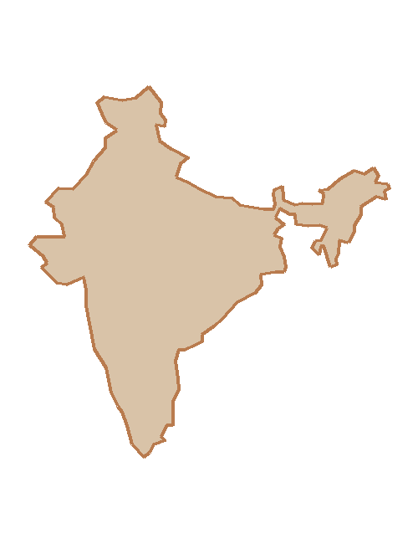

INDIA
VIETNAM
FROM VIETNAM WITH LOVE
Từ Việt Nam, với tình yêu.
×
Let's explore a lasting
partnership.
A PARTNERSHIP BETWEEN TWO MARKETS
Vietnamese coffee × Indian consumers
SuleVina Global Ventures (OPC) Private Limited | India
Contact: Mritunjay Bhardwaj, Founder
Email: mritunjay.bhardwaj@caphevietnam.in
Phone: +91 87640 01534 | Website: www.caphevietnam.in
Address: Shree Ji, Morak, Kota, Rajasthan, India 326520
Incorporation in progress | NDA available on request
CÀ PHÊ / FROM VIETNAM WITH LOVE

